Slide 1

A Case Study on Oracle
By Arshdeep singh
17103015

Slide 2
Introduction
Oracle RDBMS is a multi-model database management system produced and marketed by Oracle Corporation.

Slide 3
Facts to get started…
Oracle was founded in 1977 by Larry Ellison, Bob Miner and Ed Oates.
$39.83 billion revenue till 2018.
Oracle is the third largest software maker by revenue.
More than 137,000 employees.

Slide 4
Overview
Oracle Editions
Design and Querying tools
Variations and extensions
Storage and Indexing
Query processing
Concurrency Control and Recovery
System Architecture

Slide 5
Oracle Editions
Oracle Database Express Edition (XE) – Free to use, upto 2 CPUs, 2 GB RAM and 16 GB of user data. (Not contains features such as backup and recovery, replication)
Oracle Database Personal Edition (PE) – Single-user, Single-machine and has all the database features.
Oracle Database Standard Edition 2 (SE2) – For Small to medium size implementations, 16 concurrent user threads are allowed.
Oracle Database Enterprise Edition (EE) – No limitations on the server availability.
Oracle also have others editions such as Oracle Standard Edition and Oracle Standard Edition One.

Slide 6
Oracle SQL Developer
Oracle SQL Developer is a free graphical tool that enhances productivity and simplifies database development tasks.
With SQL Developer, you can browse database objects, run SQL statements and SQL scripts, edit and debug PL/SQL statements, manipulate and export data, and view and create reports.
You can connect to Oracle databases, and you can connect to selected third-party (non-Oracle) databases and migrate these databases to Oracle.

Slide 7
Features of Oracle SQL Developer
Execute SQL statements and scripts.
Edit and Debug PL/SQL Statements.
Migrate 3rd party database to Oracle.
Unit test PL/SQL objects.

Slide 8
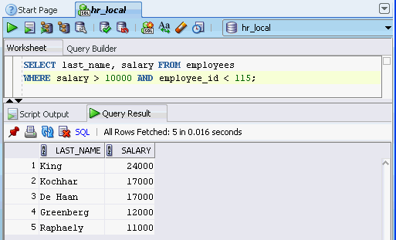
Executing SQL Script on SQL worksheet

Slide 9
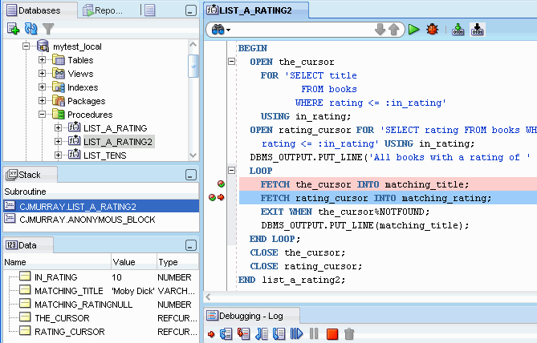
Debugging using SQL Developer
Features:-
Run
Execute
Debug
Compile for Debug
Compile
Resume
Pause
Terminate

Slide 10
Migration Wizard
The Migration wizard provides convenient, comprehensive guidance through the actions that can be involved in database migration (capturing the source database, converting it to Oracle format, generating DDL to perform the conversion, and so on). You can resolve issues during these phases, and you can then inspect or modify objects to suit your needs.

Slide 11
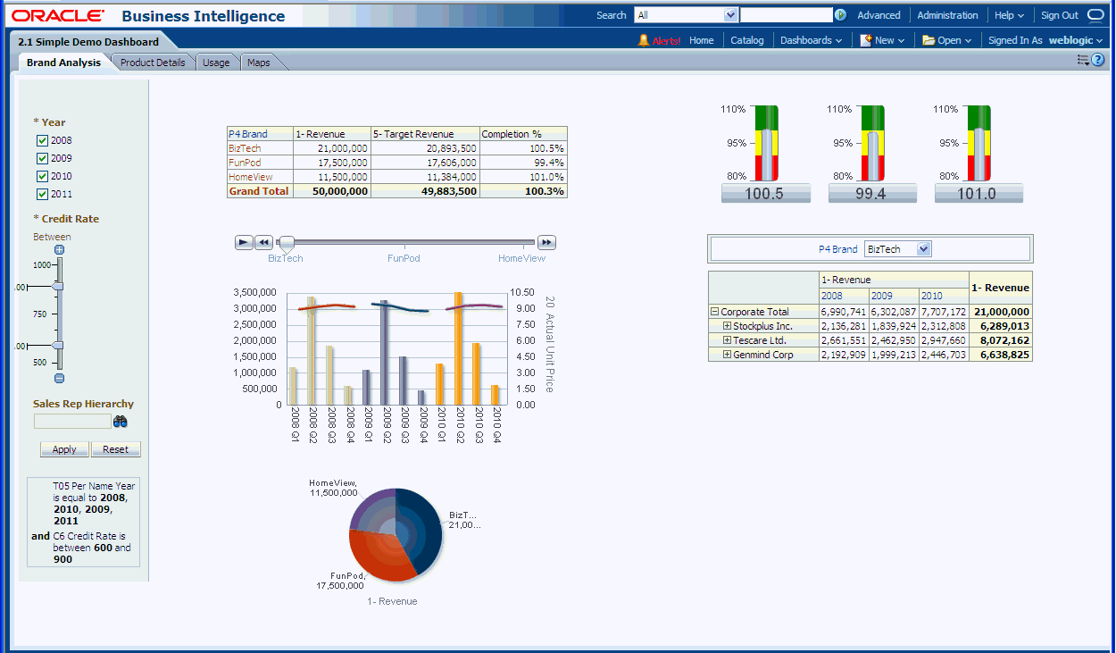
Oracle business Intelligence(OBI) Suite
Provides tools for ad hoc querying, dashboard generation, reporting, and alerting.
Presents the user with a logical view of the data hiding the details of the physical implementation
Results can be presented as charts, reports, pivot tables, or dashboards that are drillable and can be saved and later modiﬁed

Slide 12
Oracle Variations and Extensions
Oracle supports all core SQL:1999 features fully or partially
Oracle-specific in syntax or functionality
    Connect by: For transitive closure
    Upsert: Upsert combines update and insert
    Useful for merging new data with old data
    If a new row has the same key value as an old row , The old row is updated Otherwise, the new row is inserted.

Slide 13
Oracle variations and extensions
Oracle-specific in syntax or functionality
  multitable inserts
    Update multiple tables based on a single scan of new data
    INSERT ALL
    INTO dest_tab1 VALUES(id, description)
    INTO dest_tab2 VALUES(id, description)
    INTO dest_tab3 VALUES(id, description)
    SELECT id, description
    FROM source_tab;
  with clause
WITH temporaryTable(averageValue) as
(SELECT avg(Salary)
from Employee),
SELECT EmployeeID,Name, Salary
FROM Employee, temporaryTable
WHERE Employee.Salary > temporaryTable.averageValue;

Slide 14
Oracle variations and extensions
    Example: Inserting new customer information from the customers_new table into two tables, customers and customers_special.
    INSERT FIRST
    WHEN cust_credit_limit >=4500 THEN
    INTO customers_special VALUES(cust_id,cust_credit_limit)
    ELSE
    INTO customers
    SELECT * FROM customers_new;

Slide 15
Storage and Indexing
A database consists of information stored in ﬁles and is accessed through an instance, which is a shared memory area and a set of processes that interact with the data in the ﬁles.

Slide 16
Table Spaces
A database consists of one or more logical storage units called table spaces. Each table space, in turn, consists of one or more physical structures called data ﬁles.
Oracle allows moving all the data in a table space from one system to the other by simply copying the data ﬁles and exporting and importing a small amount of data-dictionary metadata. These operations can be much faster than unloading the data from one database and then using a loader to insert it into the other.
These are of three types:- System Table space, User data table space and temporary table space.

Slide 17
Segments
The space in a table space is divided into units, called segments, each of which contains data for a speciﬁc data structure. There are four types of segments:
• Data segments. Each table in a table space has its own data segment where the table data are stored unless the table is partitioned
• Index segments. Each index in a table space has its own index segment.
• Temporary segments. These are segments used when a sort operation needs to write data to disk.
• Undo segments. These segments contain undo information so that an uncommitted transaction can be rolled back.

Slide 18
Tables
A standard table in Oracle is heap organized; that is, the storage location of a row in a table is not based on the values contained in the row, and is ﬁxed when the row is inserted.
Oracle can have nested tables.
Oracle also have temporary tables for saving session information.
Oracle also supports cluster file organization. For example, a department table and an employee table could be clustered so that each row in the department table is stored together with all the employee rows for those employees who work in that department.

Slide 19
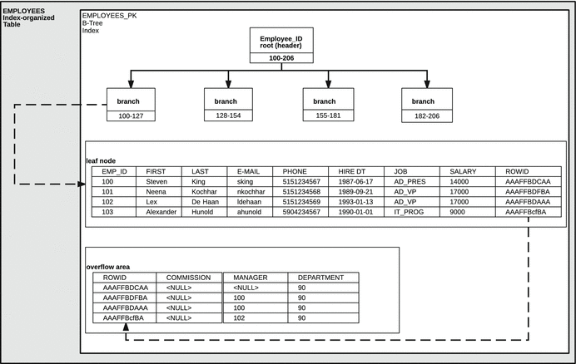
Index Organized Tables

Slide 20
Partitioning
Oracle supports various kinds of horizontal partitioning of tables and indices
And this feature plays a major role in Oracle’s ability to support very large databases
The ability to partition a table has advantages
  Backup and recovery are easier and faster
  Query performance benefits substantially

Slide 21
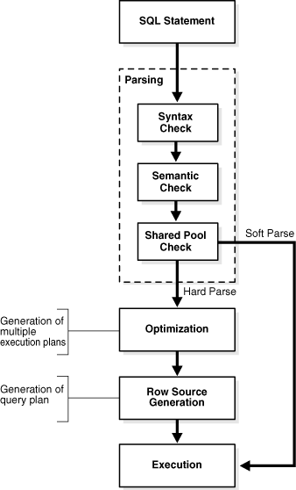
SQL Processing
SQL Parsing
The first stage of SQL processing is parsing.
The parsing stage involves separating the pieces of a SQL statement into a data structure that other routines can process. It involves –
Syntax Check, Semantic check, Shared Pool check
SQL Optimization
During the optimization stage, Oracle Database must perform a hard parse at least once for every unique DML statement and performs the optimization during this parse.
SQL Row Source Generation
The row source generator is software that receives the optimal execution plan from the optimizer and produces an iterative execution plan that is usable by the rest of the database.
SQL Execution
During execution, the SQL engine executes each row source in the tree produced by the row source generator.

Slide 22
Execution methods
  Data can be accessed through a various access methods
  Full table scan: scans the entire table.
  Index scan: scans to a relevant part of the index
  Index fast full scan: scans the extents in the same way as the table extent in a full table scan if all the required columns are present in the index table.
  Index join: is used If a query needs only a small subset of the columns of a wide table, but no single index contains all those columns

Slide 23
Parallel Execution
  Oracle allows the execution of a single SQL statement to be parallelized by dividing the work between multiple processes on a multiprocessor computer
  The degree of parallelism
    = The number of parallel server processes

Slide 24
Concurrency Control and Recovery
Concurrency Control :
  Oracle’s concurrency control differs from the concurrency mechanisms used by most other database vendors
    Basically the multiversion two-phase locking protocol
    Using System Change Number (SCN)
  During recovery from a backup, Oracle performs two steps to reach a consistent state
    First, Oracle rolls forward by applying the (archived) redo logs to the backup
    Second, Oracle rolls back uncommitted transactions by using the rollback segment
  Recovery Manager
    A GUI tool which automates most of backup and recovery tasks

Slide 25
Concurrency Control and Recovery
Oracle Data Guard :
  To ensure high availability, Oracle provides a standby database feature, Data Guard
  A standby database is a copy of the regular database that is installed on a separate system
  When a failure occurs on the primary system, the standby system is activated and takes over

Slide 26
System Architecture
Dedicated Server : Memory Structures
  The memory used by Oracle falls mainly into three categories:
    Software code areas
      the parts of the memory where the Oracle server code resides
    System global area (SGA)
      a memory area for structures that are shared among users
    Program global area (PGA)
      allocated for each process to hold its local data and control information

Slide 27
System Architecture
Dedicated Server : Memory Structures (cont.)
  The SGA is made up by several major structures
  Buffer cache
    Keeps frequently accessed data blocks in memory to reduce the need to perform physical disk I/O
  Redo log buffer
    Contains the part of the redo log that has not yet been written to disk
  Shared pool
    The sharable parts of the data structures representing the SQL statement are stored

Slide 29
System Architecture
Dedicated Server : Process Structures (cont.)
  The most important types of background processes
  Database writer
    When a buffer is removed from the buffer cache, it must be written back to disk if it has been modified since it entered the cache
  Log writer
    Writes entries in the redo log buffer to the redo log file on disk
  Checkpoint
    Updates the headers of the data file when a checkpoint occurs
  System monitor
    Performs crash recovery if needed
  Process monitor
    Performs process recovery

Slide 31
Replication
Data in a master site are replicated to other sites in the form of materialized views.
A materialized view does not have to contain all the master data—it can, for example, exclude certain columns from a table for security reasons.

Slide 32
Replication, Distributed Databases and External Data sources.
Distributed Databases
External Data Sources
Oracle supports queries and transactions spanning multiple databases on different systems. With the use of gateways, the remote systems can include non-Oracle databases. Oracle has built-in capability to optimize a query that includes tables at different sites, retrieve the relevant data, and return the result as if it had been a normal, local query.
Oracle has several mechanisms for supporting external data sources. The most common usage is in data warehousing when large amounts of data are regularly loaded from a transactional system.
A data warehouse is constructed by integrating data from multiple heterogeneous sources that support analytical reporting, structured and/or ad hoc queries, and decision making.

Slide 33
End of Presentation
References-
www.Wikipedia.org
www.Oracle.com
Database System Concepts by Abraham Silberschatz, Henry F. Korth and S. Sudarshan

